Slide 1


IPL INSIGHTS AND PREDICTIONS FOR 2024
PRESENTED BY : TAMANNA JETHWANI

Slide 2
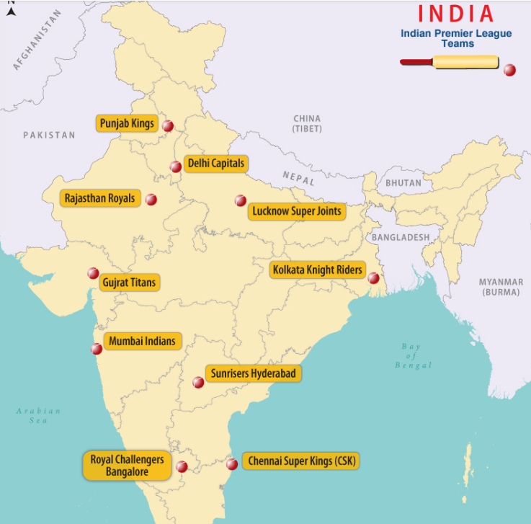
IPL TEAMS

Slide 3

PROBLEM STATEMENT
Problem Statement:
"Sports Basics" is a sports blog company that entered space recently. They wanted to get more traffic to their website by releasing a special edition magazine on IPL 2024.
Challenge : This magazine aims to provide interesting insights and facts for fans, analysts and teams based on the last 3 years' data.
Solution: This can be done by understanding and deviling deep into data to discover insights and make assumptions.
Tools used:
EXCEL
POWER BI

Slide 4
META DATA
This document contains all the meta information regarding the columns described in the CSV files for a comprehensive analysis of IPL matches over the past three years (2021, 2022, 2023). The CSV files are as follows :
1. dim_cricket_game_match_ summary
2. dim_cricket_team_players
3. fact_cricket_game_batting_summary
4.
4. fact_cricket_game bowler_ summary

Slide 5
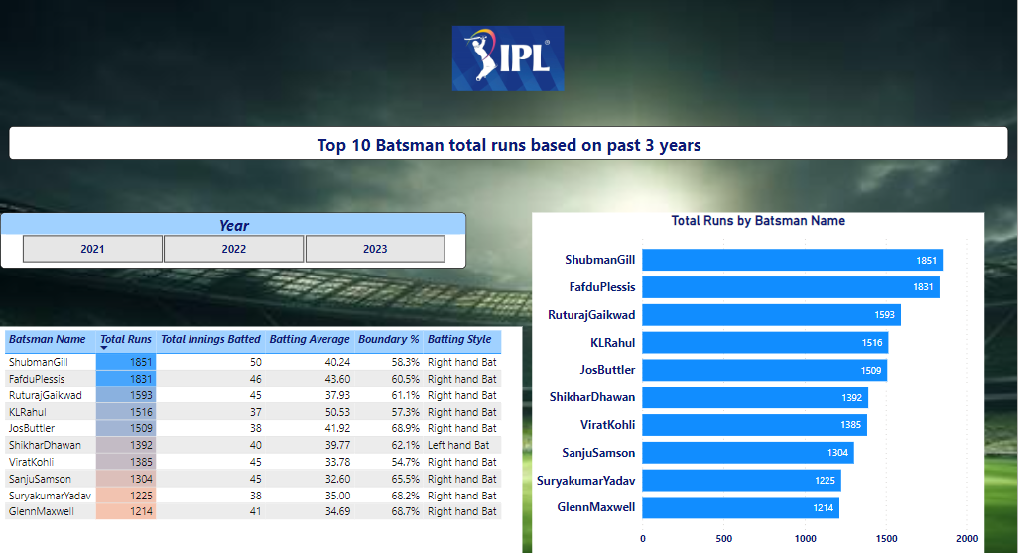
TOP 10 BATSMAN

Slide 6
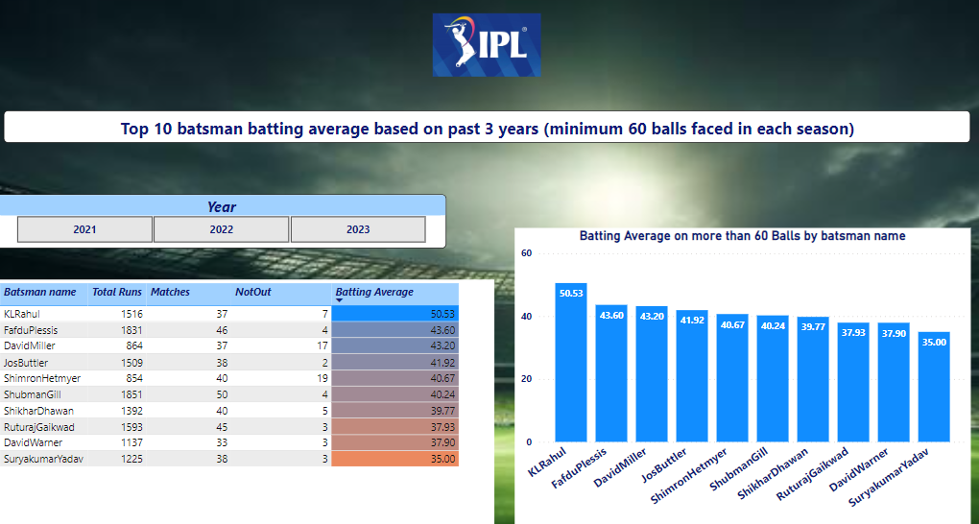
TOP 10 BATSMAN BATTING AVERAGE
Notes:
Batting average is calculated to evaluate the performance of the batsman. Total number of runs scored by batsman and number of times the batsman got out.

Slide 7
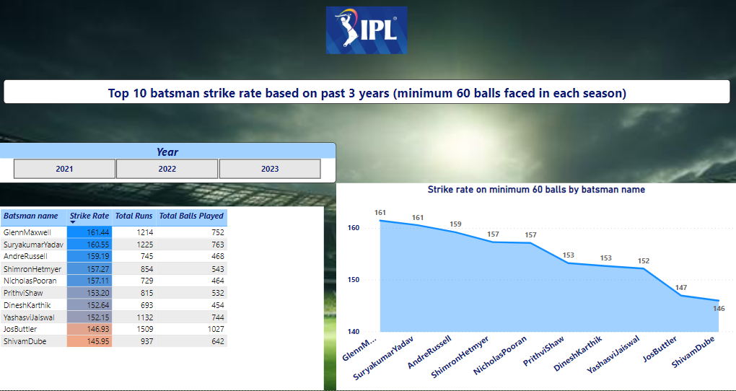
TOP 10 BATSMAN STRIKE RATE
Notes:
Strike rate represent number of runs scored by a batsman per 100 balls faced.

Slide 8
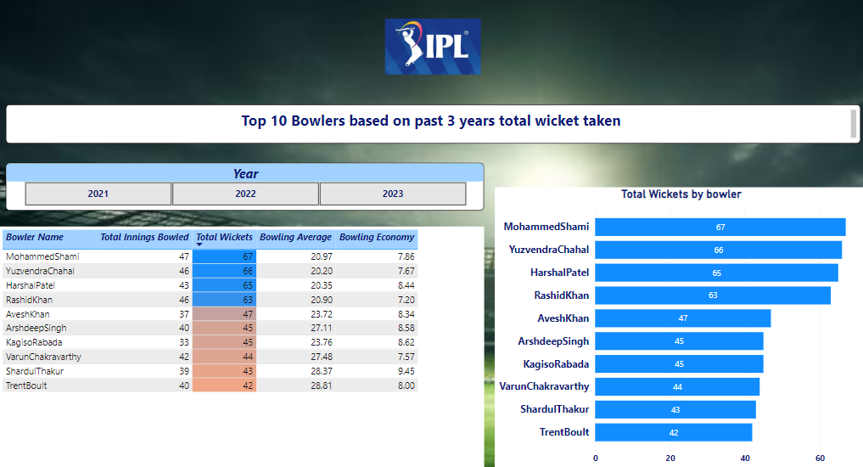
TOP 10 BOWLERS

Slide 9
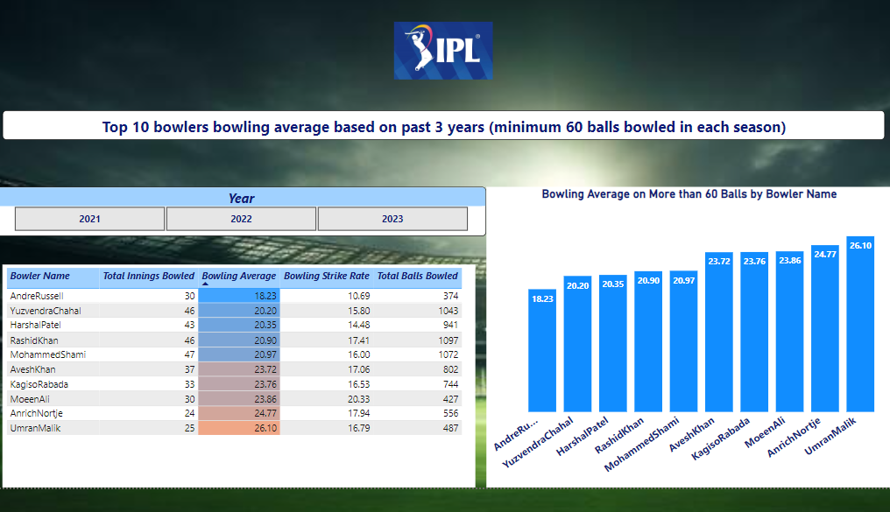
TOP 10 BOWLERS BOWLING AVERAGE
Notes:
Bowling average is used to access the effectiveness of the bowler. It indicates average number of runs a bowler concedes per wicket taken

Slide 10
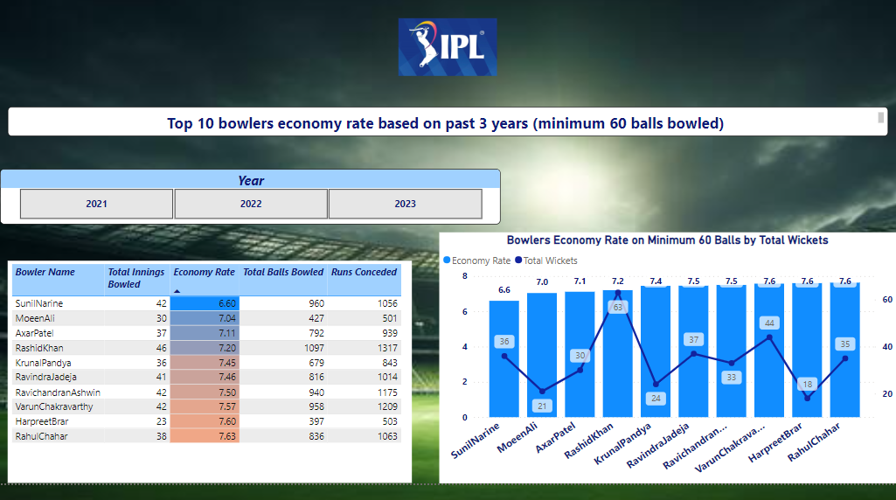
TOP 10 BOWLERS BASED ON ECONOMY RATE
Notes:
Economy rate is calculated by total number of runs conceded by total number of overs bowled and then multiply by 6 to get the economy rate.

Slide 11
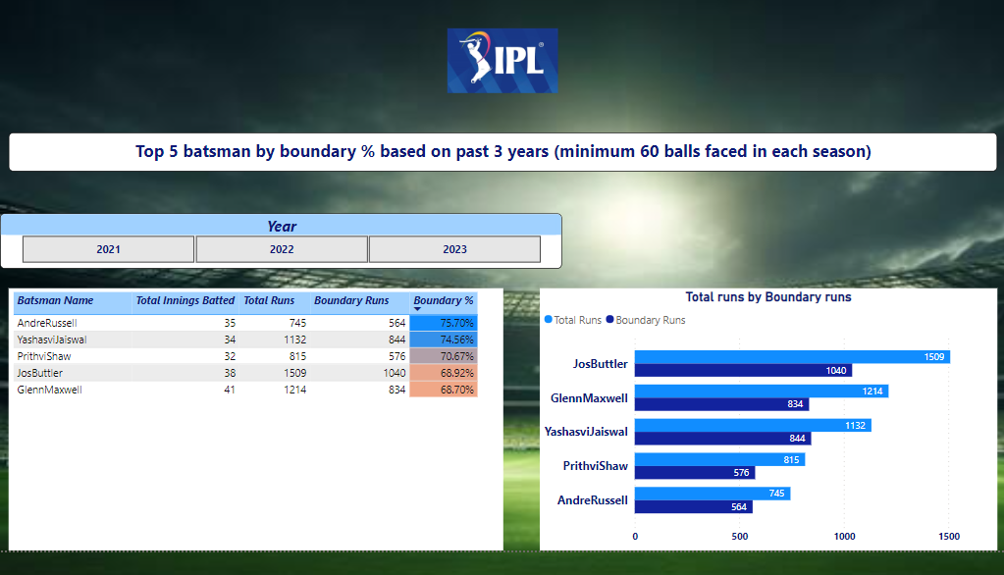
TOP 5 BATSMAN BY BOUNDARY%

Slide 12
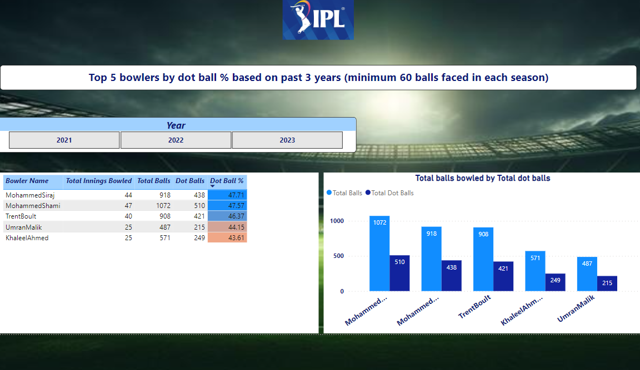
TOP 5 BOWLERS BY DOT BALL %
Notes:
No runs were given by the bowler on that ball.

Slide 13
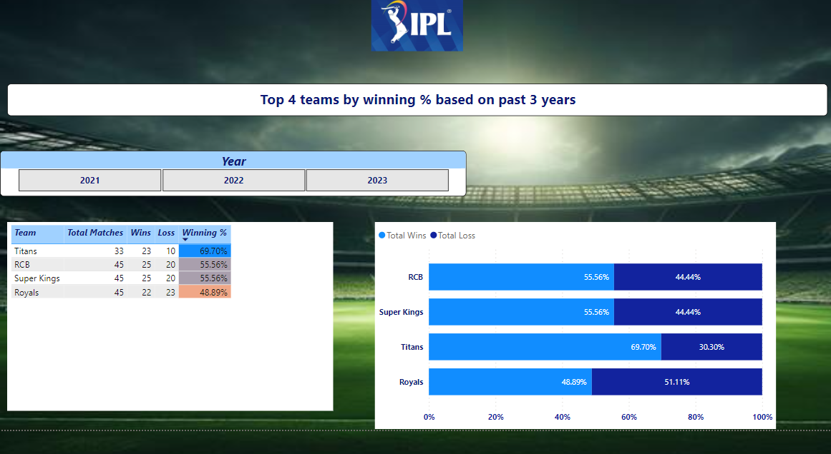
TOP 4 TEAMS BY WINNING %

Slide 14
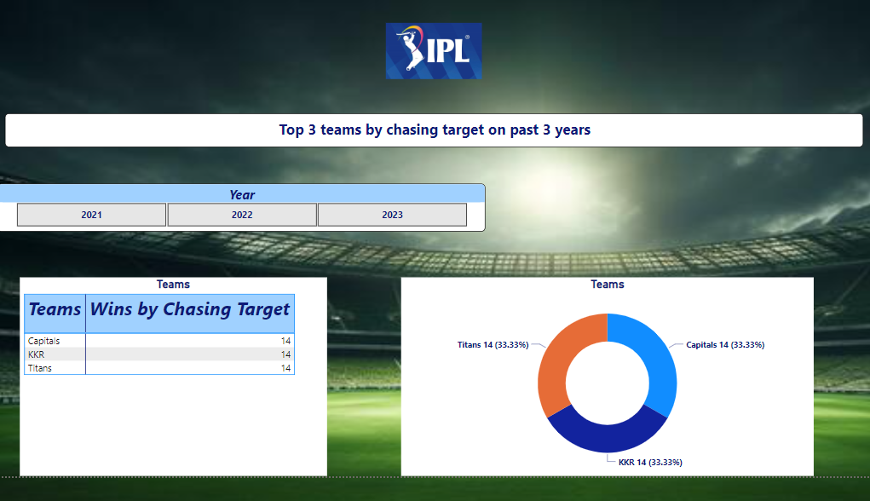
TOP 2 TEAMS BY CHASING TARGET

Slide 15
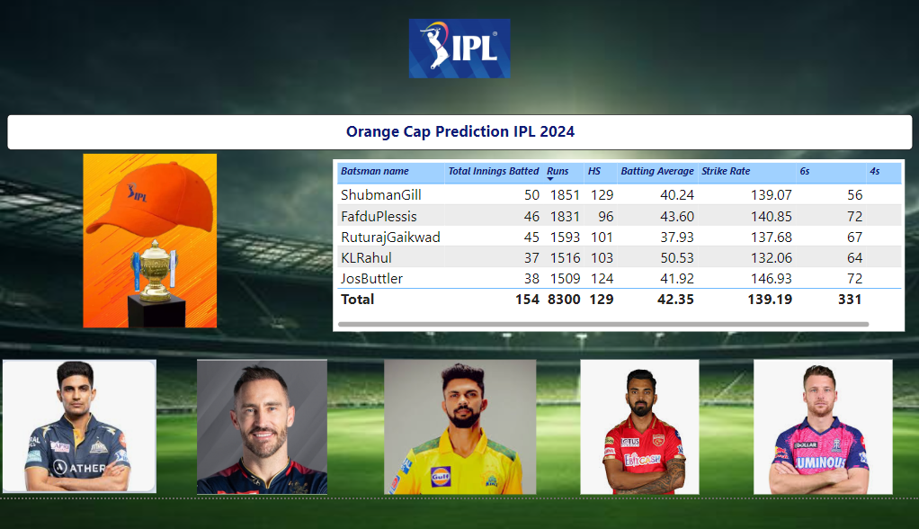
ORANGE CAP PREDICTION

Slide 16
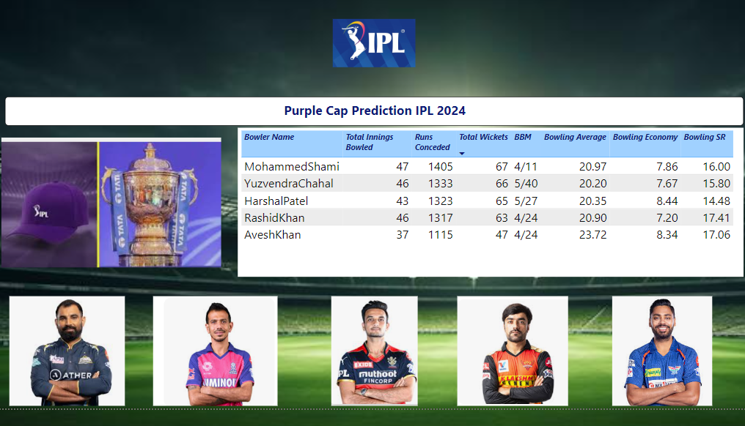
PURPLE CAP PREDICTION

Slide 17
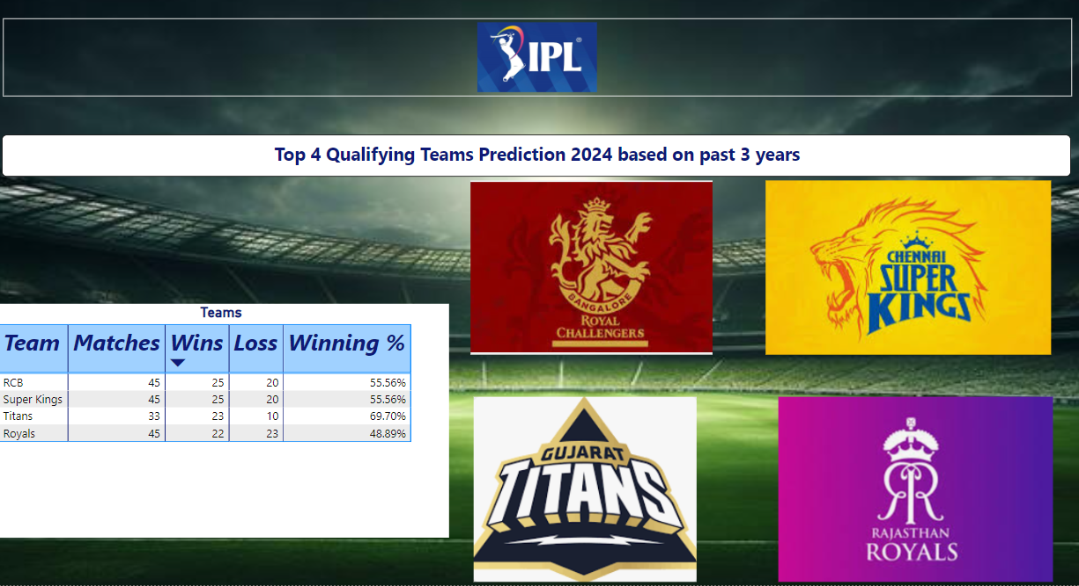
QUALIFYING TEAMS PREDICTION

Slide 18
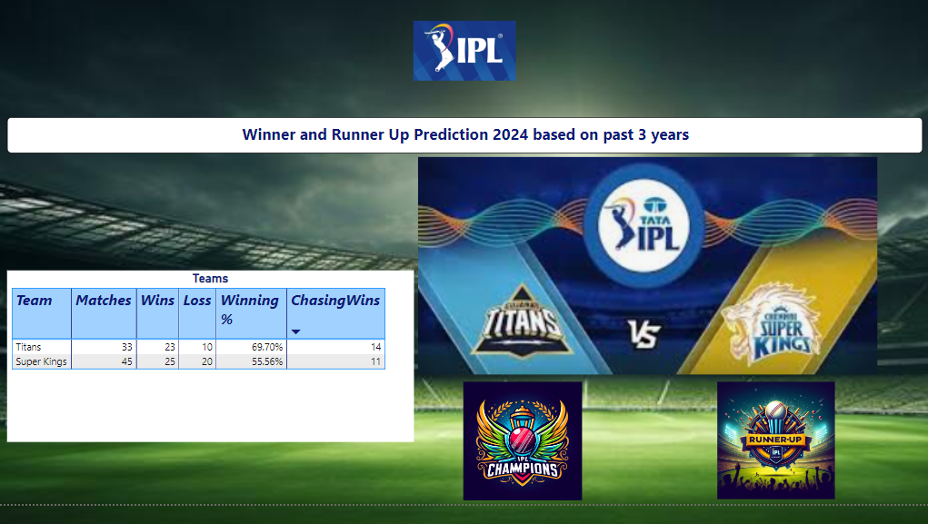
WINNER AND RUNNER UP PREDICTION

Slide 19
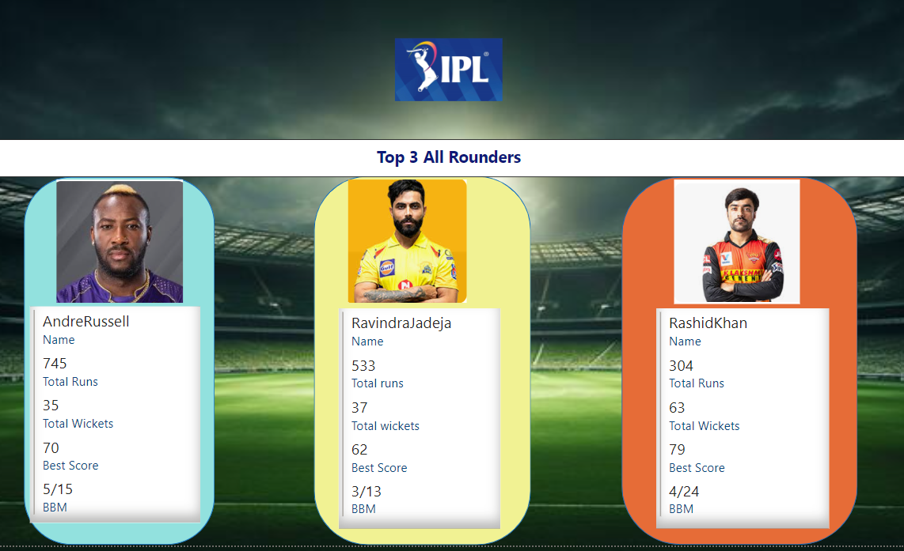
TOP 3 ALL ROUNDERS

Slide 20
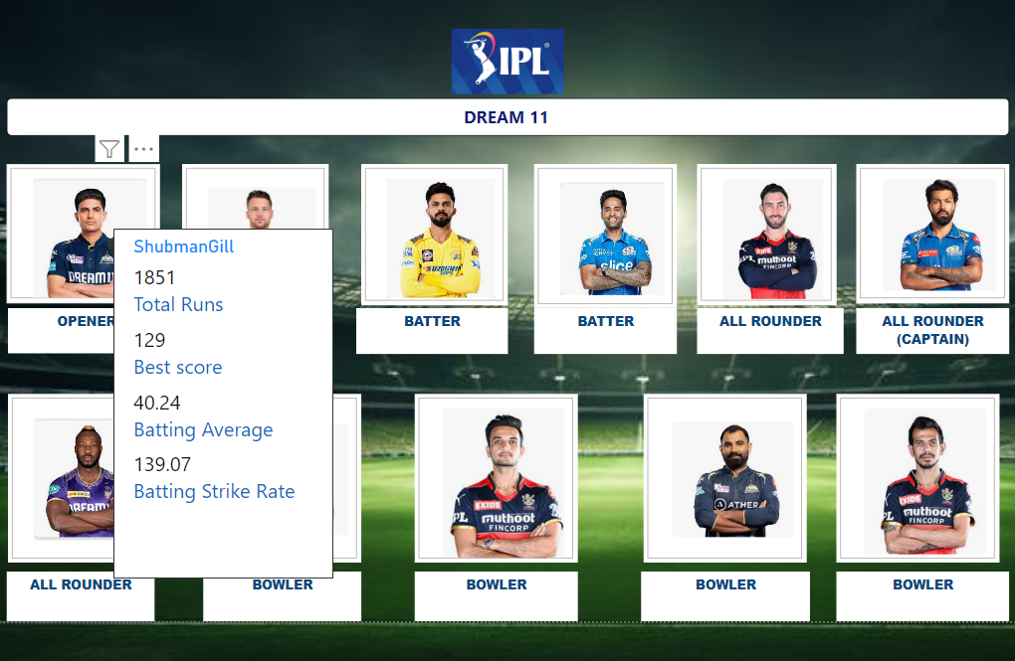
DREAM 11
Notes:
Tooltip applied for all the players to display information about the players

Slide 21

THANK YOU CODEBASICS FOR CONDUCTING THE CHALLENGE

